Slide 1



FINAL AUTOMATION PROJECT
MOHAMMED HUSSIEN

Slide 2
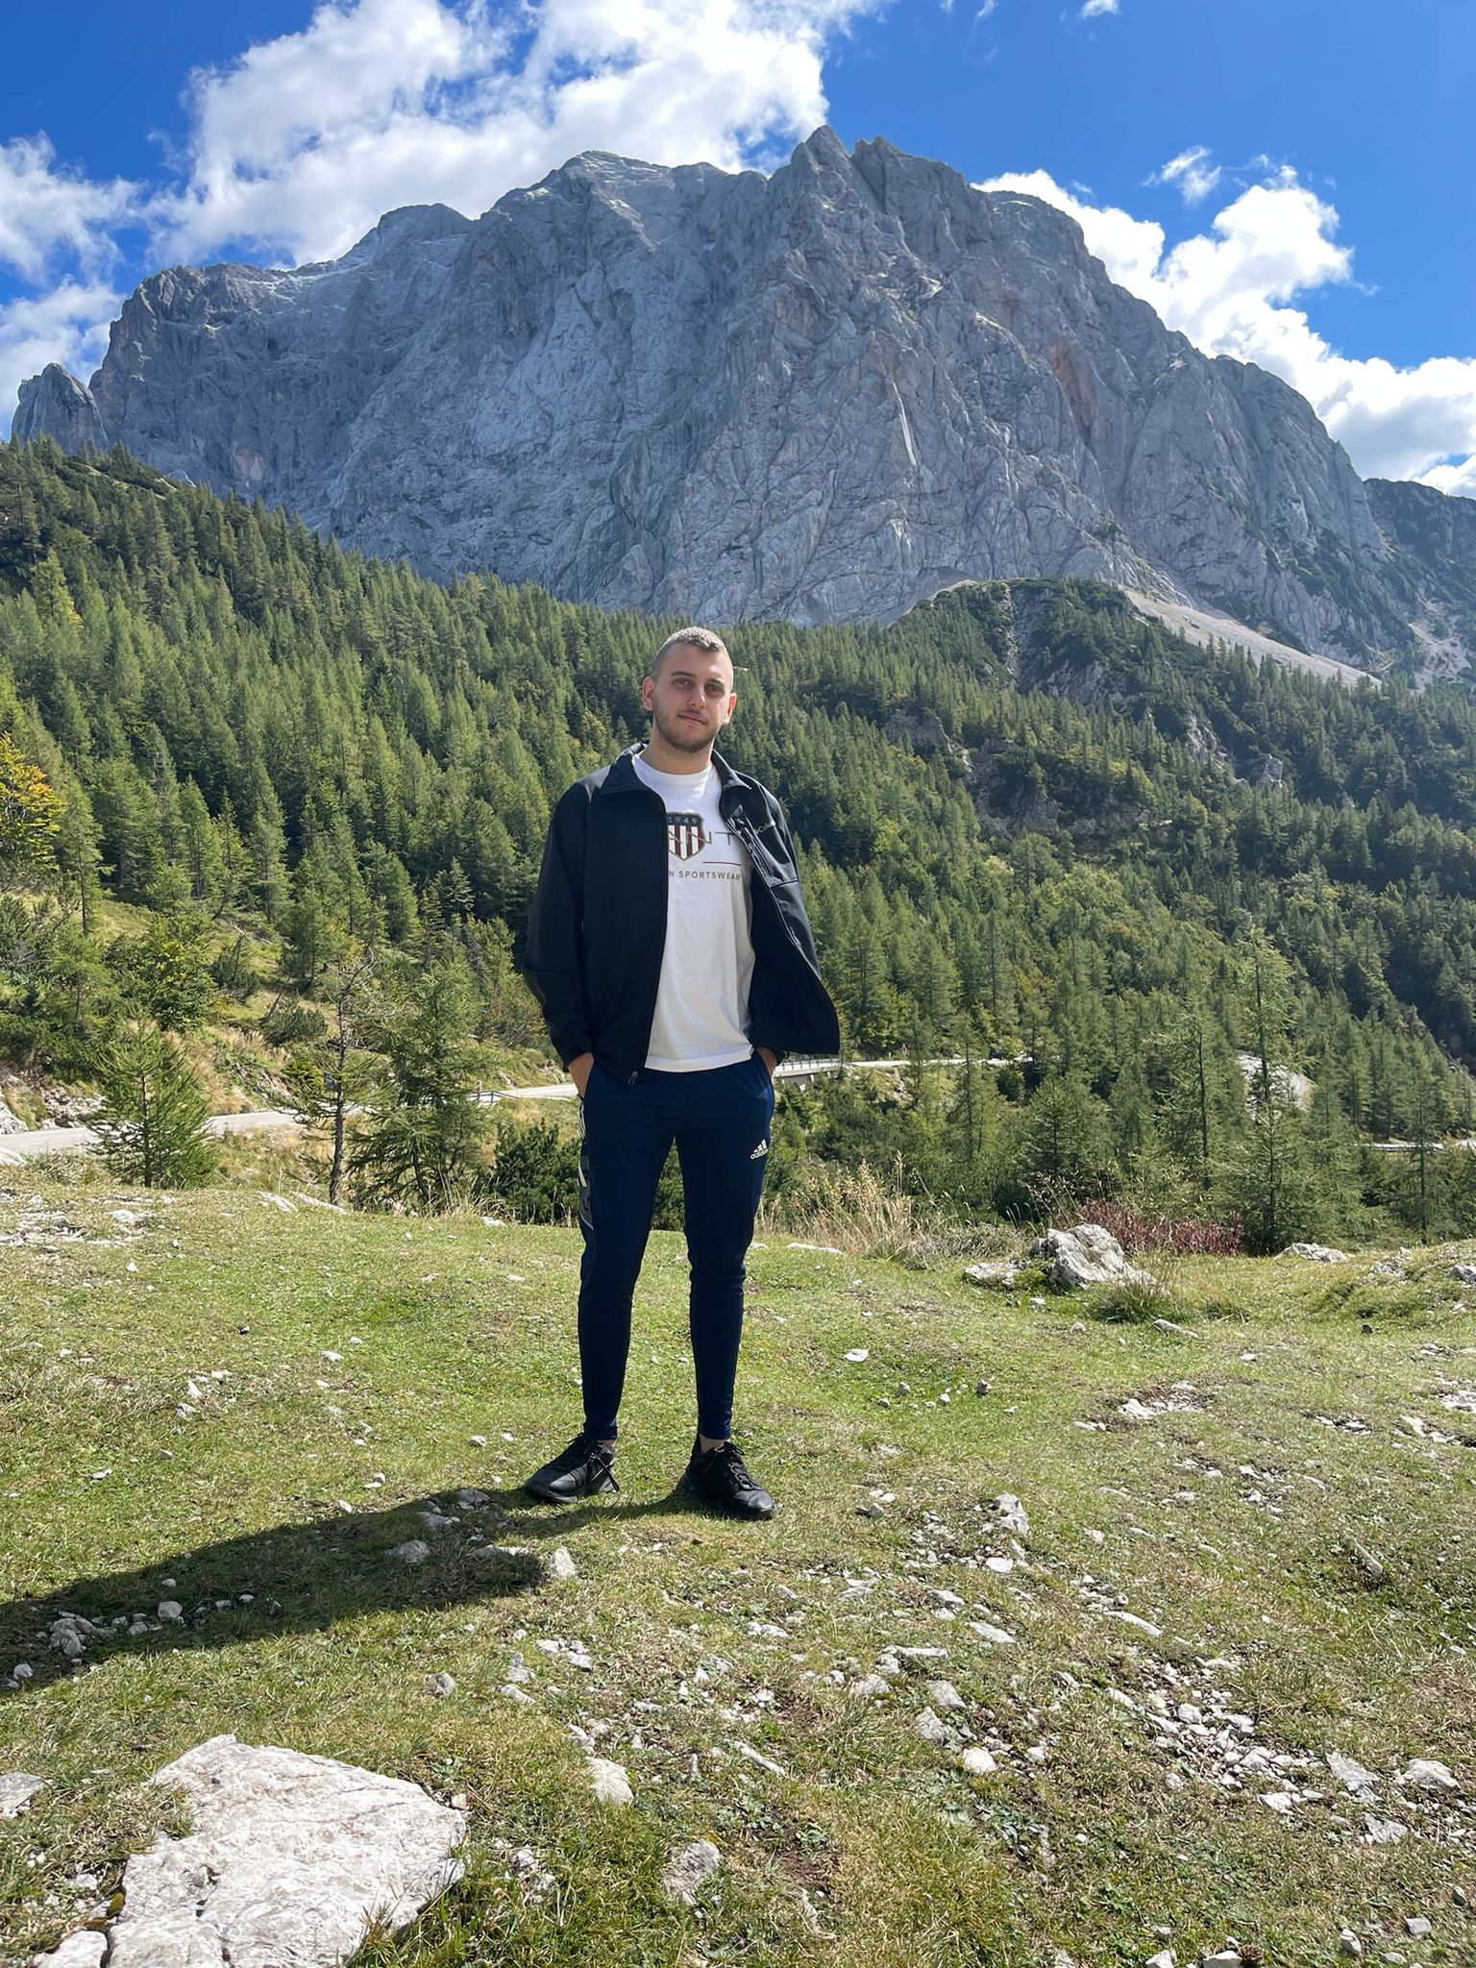

About me
A 23-year-old hailing from Deir Hanna village.
Graduated in Computer Science from the University of Haifa.
Enjoys hobbies such as cooking, traveling, and coding.
Enthusiastic about expanding knowledge and thriving in the field of automation.

Slide 3
TABLE OF CONTENTS
01
02
03
04
05
06
Introduction
About the website
STP File
Introduction to the Project
Selection and Analysis of the Website
About the STP file and what does it include
STD File
Demonstration
Key Takeaways
About the STD file and what does it include
Opening the code and running a test example
Challenges faced and lessons learned .

Slide 4


Introduction
Our objective is to create automated tests for a selected website to ensure the functionality of its features.
Tests are designed to verify the proper functioning of key features on the chosen website.
The project focuses on automation testing using Python with Selenium and Selenium Grid also incorporated Continuous Integration with GitActions.
The entire project was managed through GitHub due to its efficient version control and collaboration features.

Slide 5
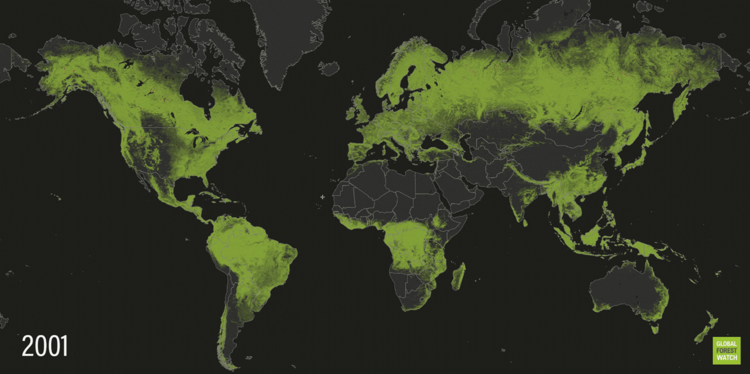

GLOBAL FORST WATCH
Real-time information about forests all around the world.

Slide 6

Why is the GFW website good for automated testing?
API Integration: GFW offers an open APIs that facilitate automated data retrieval and analysis, streamlining testing processes.
Real-time Updates: GFW continuously updates its data, enabling automated tests to reflect the most recent changes in forest conditions.
Data Consistency: GFW's centralized platform ensures that forest monitoring data is consistently structured, making it ideal for automated testing purposes.

Slide 7

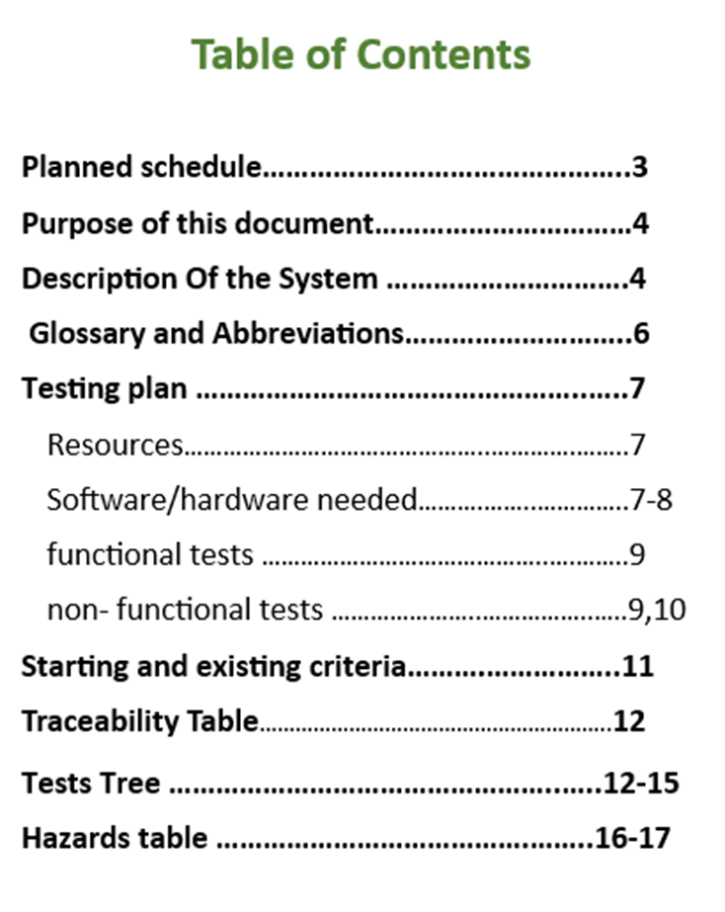
THE STP FILE
The purpose of the document is to define a framework program for testing This framework plan will include all relevant topics for planning and performing the tests, such as the test topics and types of tests, the schedule, and the planned work method for testing the system.

Slide 8

Definitions and examples:
Functional tests verify that the software functions as expected, based on its specifications and requirements.
Example : Verify that we can successfully add an area to my list of areas.
Non-functional tests evaluate aspects like performance, usability, and security, ensuring the software meets user expectations beyond its basic functionality.
Example: Conducting a stress test by inputting an exceptionally long string to evaluate system behavior.
Negative tests focus on intentionally breaking the software by providing invalid inputs or unexpected scenarios, validating its resilience and error-handling capabilities.
Example: entering an invalid search query and verifying that the system displays an appropriate error message.

Slide 9

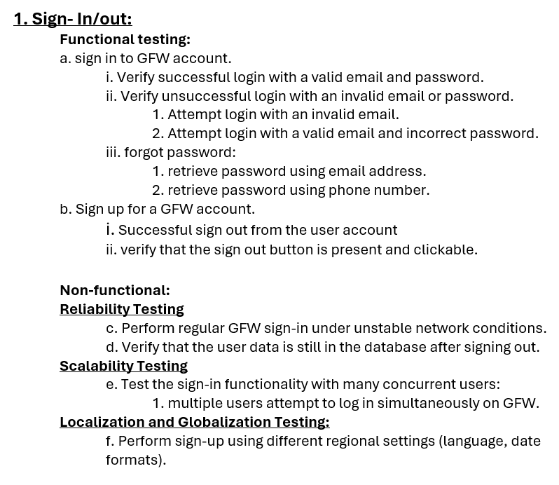
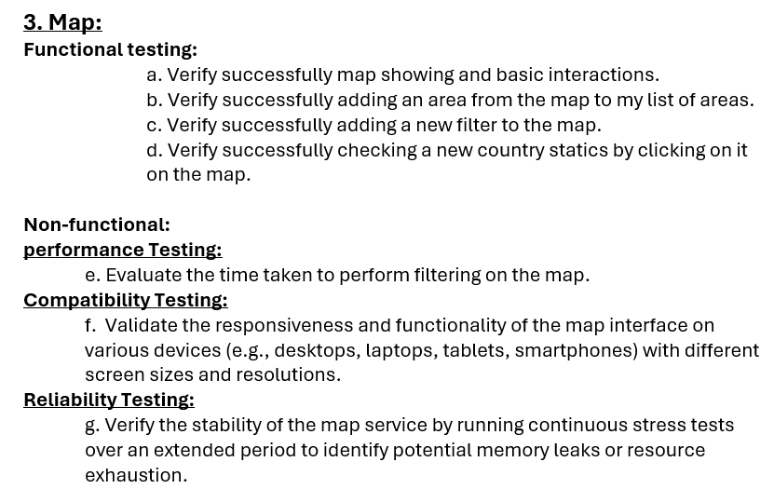
TESTING TREE

Slide 10
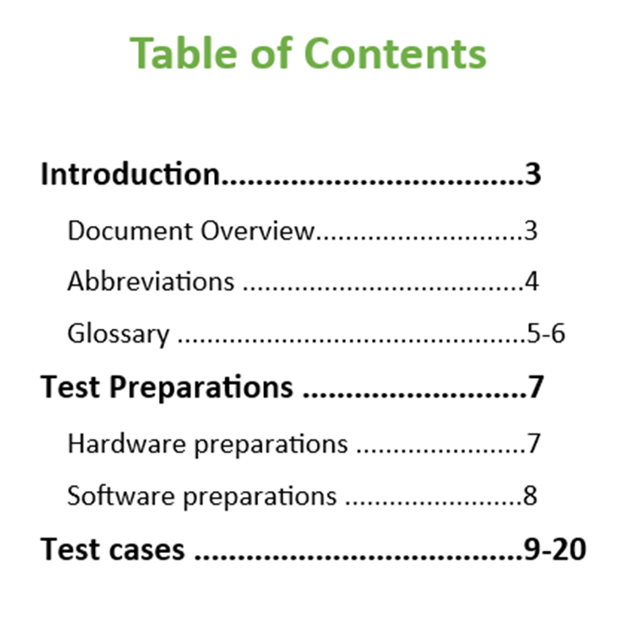
THE STD FILE
This document serves as the software test description for the GeeksforGeeks software development project. It provides a comprehensive overview of the tests outlined in the software test plan. These tests are important to the success of the project as they include both functional and non-functional aspects, ensuring the platform's stability and reliability.

Slide 11
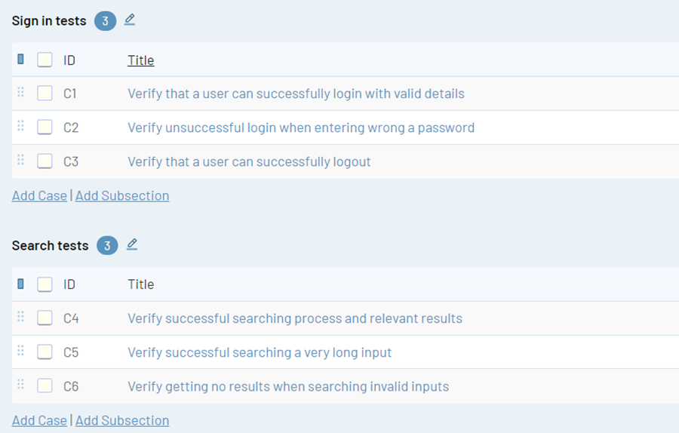
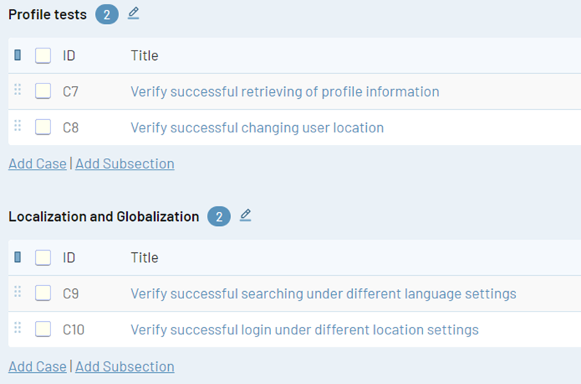
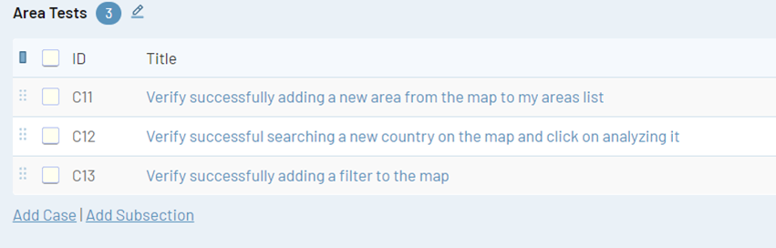
TEST CASES

Slide 12
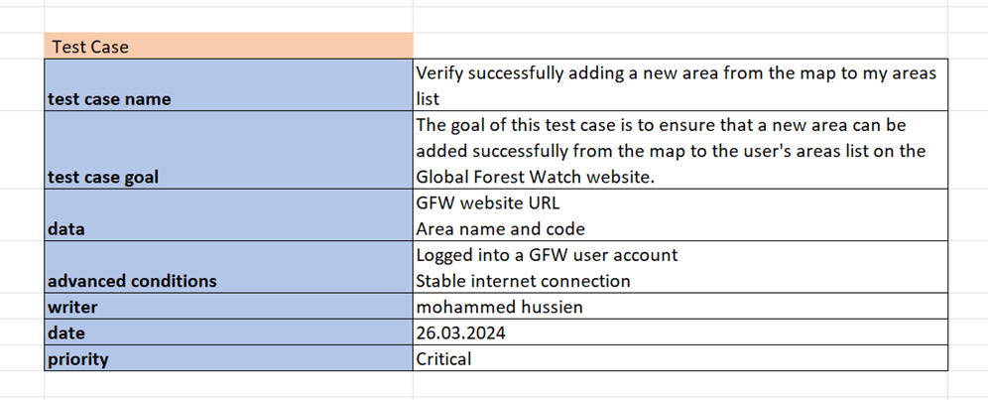


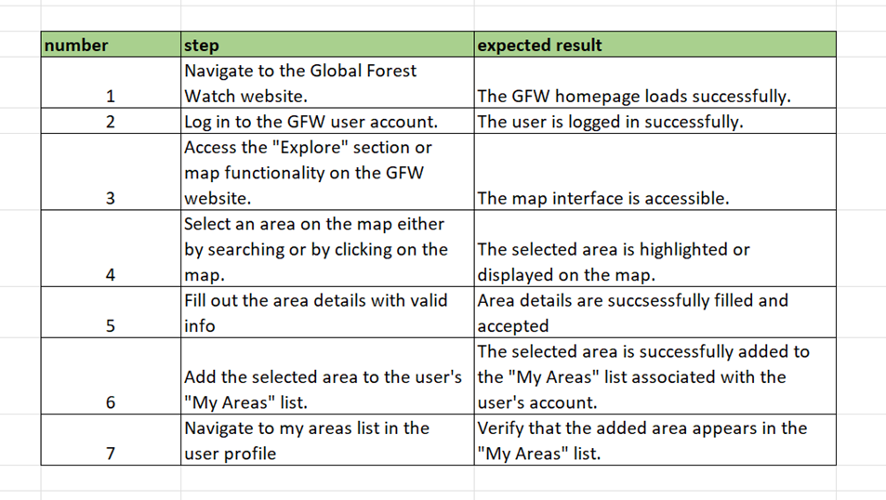
Test case example

Slide 13


LIVE DEMO

Slide 14
CHALLENGES FACED
The presence of interactive map components on the website posed a unique challenge for testing, Interacting with maps often requires specialized testing approaches
limited coverage of API tests. With fewer API endpoints to test, it became challenging to find a diverse set of meaningful test cases.
Sticking to the project timeline without straying or falling behind to ensure deadlines are met efficiently.

Slide 15

LESSONS LEARNED
Effective Time Management: Learning to prioritize tasks and allocate time efficiently was crucial for meeting project deadlines.
Good Code Structure: Maintaining a well-structured codebase helped in enhancing code readability, reusability, and maintainability, reducing the likelihood of errors.
Documentation: Maintaining comprehensive documentation for code, test cases, and project progress was vital for knowledge sharing and future reference.

Slide 16
HOW TO SAVE THE TREES
Educating yourself is the crucial first step in the fight for the earth’s forests. Once you know how to protect our forests, you can go out and show others how to save trees too! In this article we’ll discuss these 5 ways that you can preserve our forest:
01
Planting Trees
02
Buy Forest Alliance Certified Products
03
Support Organizations
04
Use Tree-Free Products
05
Enjoy Forests Responsibly

Slide 17
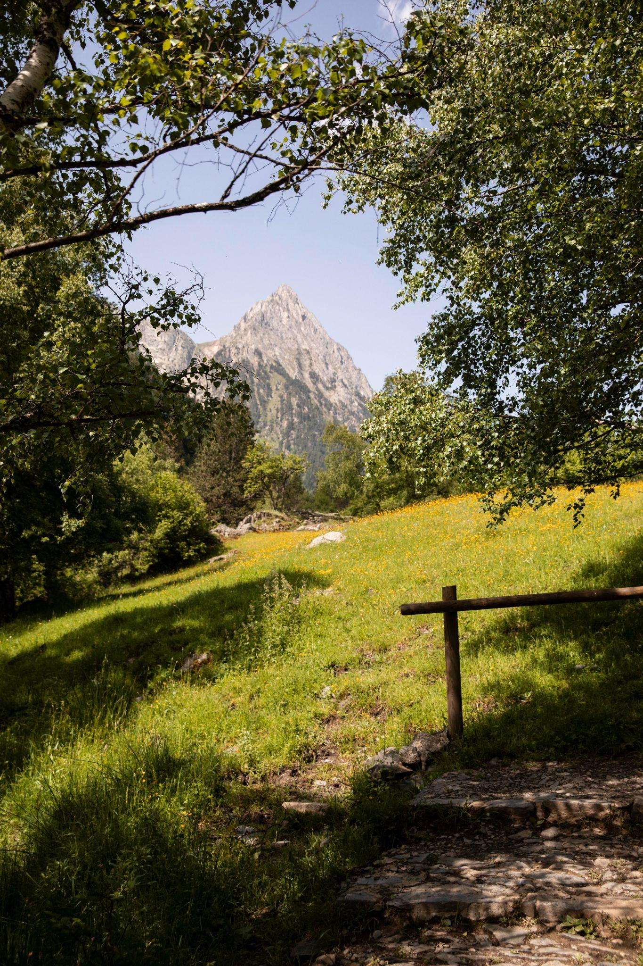
THANKS!
Any questions?
mhmdhuss44@gmail.com

